Slide 1
The Path to IAM Maturity
Jerod Brennen, Security Architect

Slide 2


“Are we secure?”

Slide 3
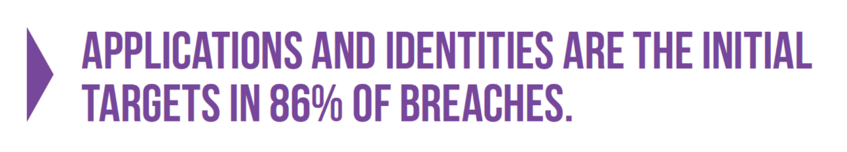
A Decade of Data Breaches: Lessons Learned
From https://www.f5.com/labs/articles/threat-intelligence/lessons-learned-from-a-decade-of-data-breaches-29035

Slide 4
Maturity = Security

Slide 5
IAM Fundamentals
Maturity Models
Getting From Here to There
Next Steps

Slide 6
IAM Fundamentals

Slide 7
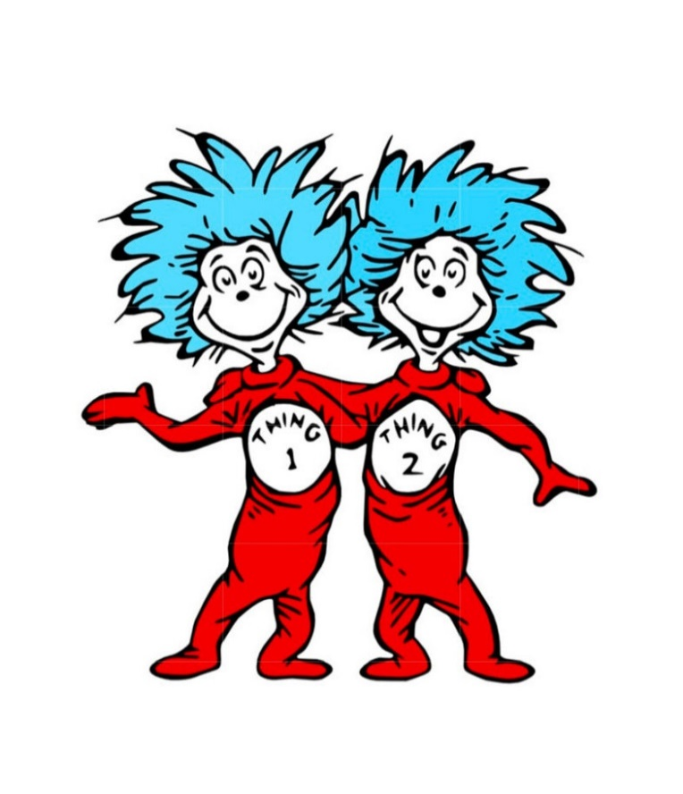
Users Need “Things”
Entitlements – The things tied to a user (hardware, licenses, access, etc.)
Attributes – Flags that indicate which things a user should have
Provisioning – Granting entitlements to a user account
Deprovisioning – Removing entitlements from a user account

Slide 8
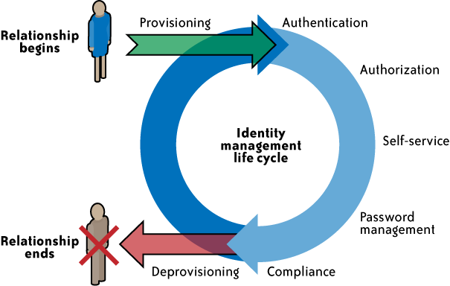
Traditional IAM Lifecycle
Image from https://www.kuppingercole.com/watch/consumer_focused_identity_management

Slide 9
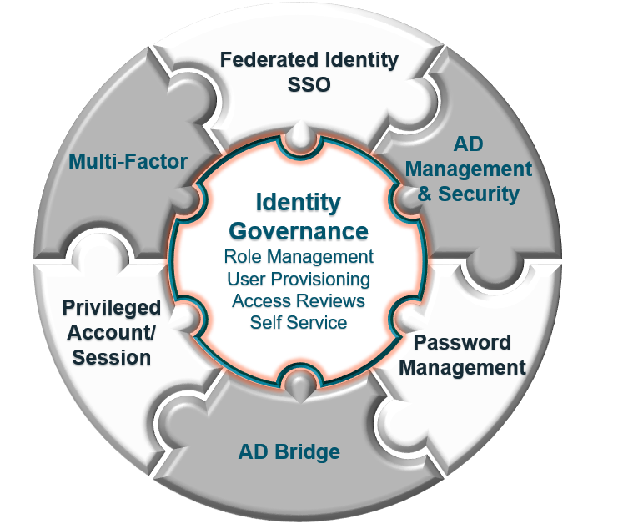
IAM Governance

Slide 10
Maturity Models

Slide 11
Capability Maturity Model
Level | Description
5 - Efficient | Process management includes deliberate process optimization/improvement.
4 – Capable | The process is quantitatively managed in accordance with agreed-upon metrics.
3 – Defined | The process is defined/confirmed as a standard business process.
2 – Repeatable | The process is at least documented sufficiently such that repeating the same steps may be attempted.
1 – Initial | Chaotic, ad hoc, individual heroics; the starting point for use of a new or undocumented repeat process.
From https://en.wikipedia.org/wiki/Capability_Maturity_Model

Slide 12
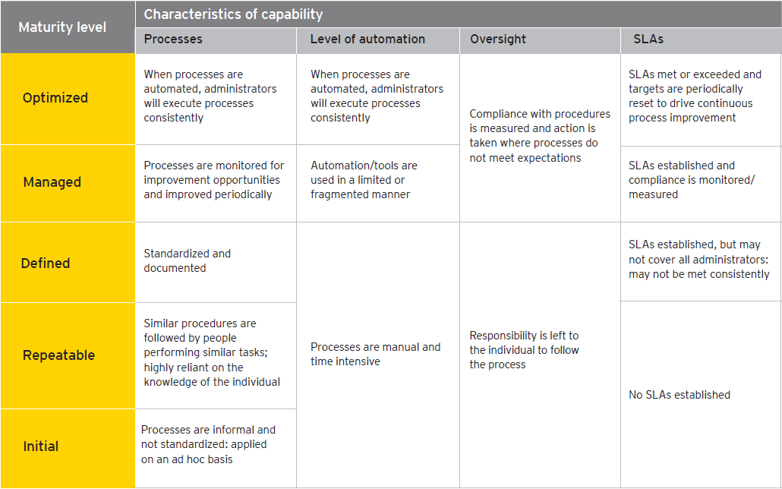
EY
From https://www.ey.com/Publication/vwLUAssets/EY_-_Evolving_identity_and_access_management/$FILE/EY-Evolving-identity-and-access-management.pdf

Slide 13
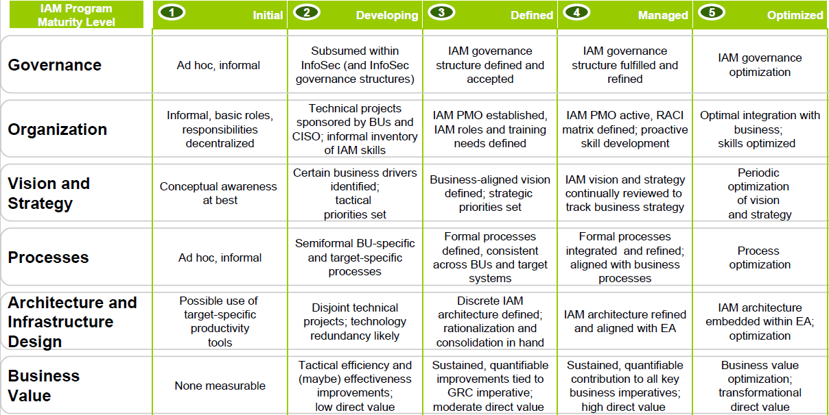
Gartner
From https://www.slideshare.net/smooregartner/the-gartner-iam-program-maturity-model

Slide 14
Getting From Here to There

Slide 15
1 – Initial
Chaotic, ad hoc, individual heroics; the starting point for use of a new or undocumented repeat process.
Getting from 1 to 2
Perform an IAM program maturity assessment
Document manual procedures
Explore automation opportunities (provisioning, deprovisioning, self-service password resets)

Slide 16
2 – Repeatable
The process is at least documented sufficiently such that repeating the same steps may be attempted.
Getting from 2 to 3
Document IAM policies, procedures, and standards
Start consolidating identities (centralize directories, single sign-on, federated authentication)
Take inventory of privileged/service accounts
Take inventory of remote/cloud users and applications

Slide 17
3 – Defined
The process is defined/confirmed as a standard business process.
Getting from 3 to 4
Align provisioning/deprovisioning activities with business processes
Explore integration between IAM and security incident response
Improve privilege management (2FA)
Improve remote/cloud IAM (2FA)
Document IAM metrics
Notes:
Streamline user identity management, privilege access, and security
Integrate IAM with incident response
SSO / federation for SaaS applications

Slide 18
4 – Capable
The process is quantitatively managed in accordance with agreed-upon metrics.
Getting from 4 to 5
Improve IAM / business process integration
Measure and manage those improvements
Update IAM controls in conjunction with policies, procedures, and standards
Notes:
Refine existing IAM controls, based on feedback from the business.

Slide 19

5 - Efficient
Process management includes deliberate process optimization / improvement.

Slide 20
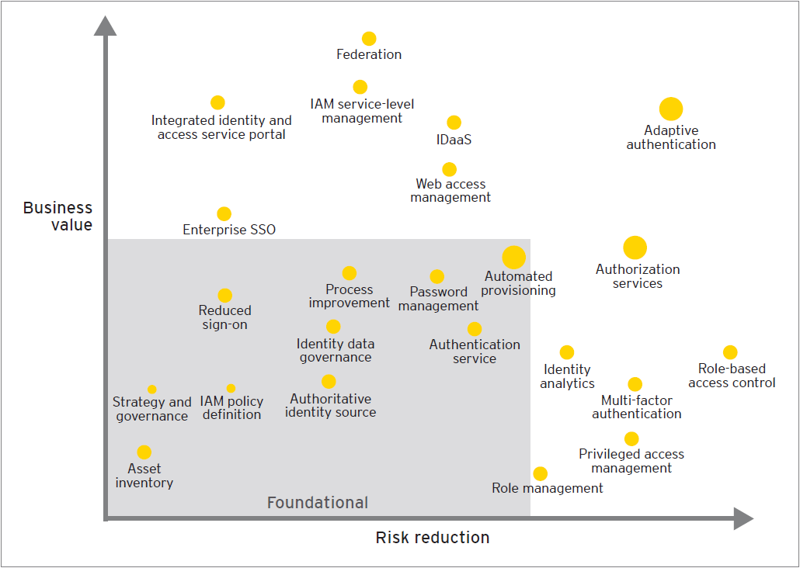
EY IAM Transformation Graph
From https://www.ey.com/Publication/vwLUAssets/EY_-_Evolving_identity_and_access_management/$FILE/EY-Evolving-identity-and-access-management.pdf
Notes:
By understanding an individual organization’s drivers (business value vs. risk reduction), we can help them identify the solutions closely aligned with those drivers.

Slide 21
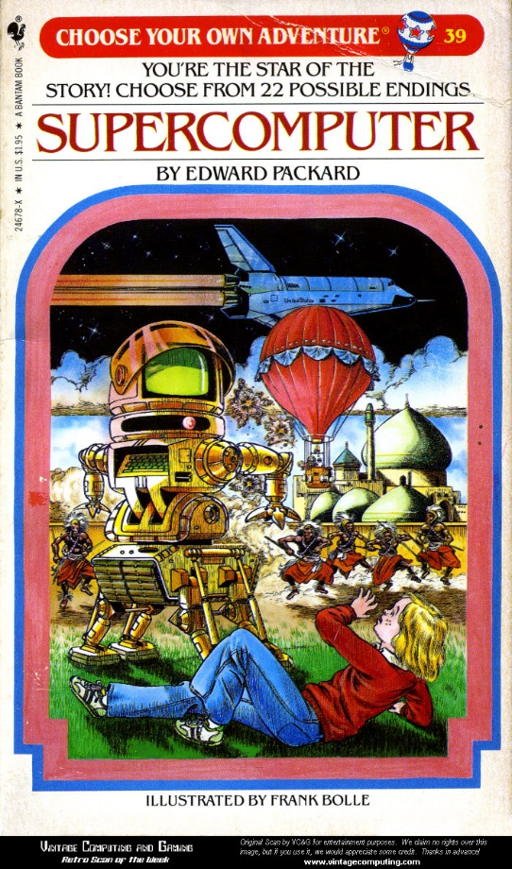
Point Solution or Platform?
Feature set (want vs. need)
Architecture (open vs. closed)
IT resource availability
User experience
Total cost of ownership

Slide 22
Next Steps

Slide 23
Ask Strategic Questions
Do you have an IAM strategy in place?
If so, what is that strategy?
Do you have executive/stakeholder support for your IAM initiatives?
How would you prioritize the following IAM benefits?
Governance
User & Administrator Experience (e.g., automation, efficiency)
Cost Avoidance / Cost Reduction
How widespread is current SaaS/PaaS/IaaS usage in your environment?

Slide 24
People
Start talking to people (users, administrators, HR)
Identify your internal advocates (leadership, business, IT, etc.)
Engage (or assemble) your Information Security/Risk Governance Committee

Slide 25
Process
Identify your IAM processes (manual and automated)
Sit down with those being provisioned to learn the process
Sit down with those doing the provisioning/deprovisioning to learn the process

Slide 26
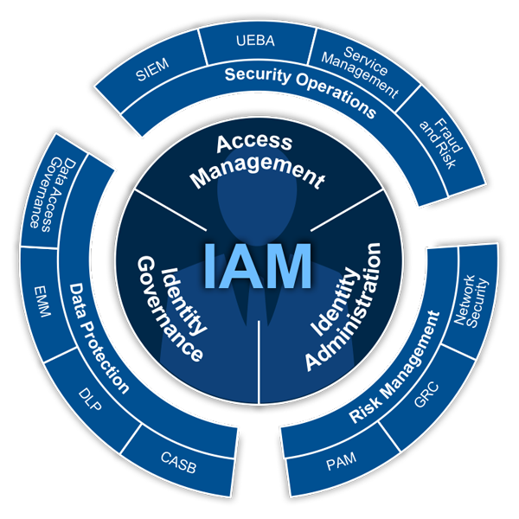
Technology
From https://www.idsalliance.org/framework/

Slide 27
Resources
Capability Maturity Model
https://en.wikipedia.org/wiki/Capability_Maturity_Model
Gartner IAM Program Maturity Model
https://www.slideshare.net/smooregartner/the-gartner-iam-program-maturity-model
EY - Identity and access management - Beyond compliance
http://www.ey.com/gl/en/services/advisory/identity-and-access-management---beyond-compliance
Using an IAM maturity model to hone identity and access management strategy
http://searchsecurity.techtarget.com/tip/Using-an-IAM-maturity-model-to-hone-identity-and-access-management-strategy

Slide 28

Contact Info
Email – Jerod.Brennen@OneIdentity.com
LinkedIn - https://www.linkedin.com/in/slandail/
Twitter - https://twitter.com/slandail
GitHub - https://github.com/slandail
SlideShare - https://www.slideshare.net/JerodBrennenCISSP
Speaker Deck - https://speakerdeck.com/slandail/

